Slide 1
Submeter Initial Data Exploration
By James Sanders

Slide 2
Agenda:
Background
Objective/Goals
Data Management
Descriptions and location of related data.
Any known issues with the data and how you plan to address them.
Descriptive statistics you gathered as an initial step in analysis.
High-Level Recommendations
Closing

Slide 3
Background
Submeters are a way for residential buildings to bill tenants for individual electricity usage. They are below the master-meter which is owned by the electric company. There are many benefits of submetering a master-metered building, they affect the owner, residents, and utility companies. These benefits include:
Energy Savings
Lower Utility Costs
Fairer Allocations of Energy COsts

Slide 4
Objective and Goals:
IOT Analytics has been asked to analyze a set of data for a client that is building a “Smart Home” residential apartment building. The data set pertains to a building that has been submetered, and IOT analytics has been asked to “evidence or positive reasons for adopting the use of electrical sub-metering devices used for power management in Smart Homes”

Slide 5
Data Management
Data for this project will be downloaded over secure password protected networks. It will be keep locally on a password protected computer, and this computer will not be unattended while unlocked. The data will be downloaded, cleaned and pre-processed, and then an exploratory analysis of the data will be performed.

Slide 6
Descriptions and location of related data:
We were given access to 5 years(2006 - 2010) of data from a submetered building in Paris, France. This data was available from a public SQL database. We were given access to a total of 47 months of data, of which 1569894 entries were analyzed. The features we used were date, time, and respective electric use for submeter 1, submeter 2, and submeter 3 respectively.

Slide 7
Known Data Issues and How They Were Addressed
1.Feature selection: Several features that were unnecessary to further analysis were dropped from the dataframe. These features were: ID, Global Active Power, Global Reactive Power, Global Intensity, Voltage
2. We then inspected the data sets from each year. Only years with 12 months are being used for further analysis. The data sets from years 2007, 2008, and 2009 were selected.
3. The data needs to be in one table in order to do a total analysis. In order to achieve this we joined data frames from 2007, 2008, and 2009 into one data frame.
4. Date and Time are two individual features in the data frame that need to be combined into one features. A time zone was also assigned to the data based on the location data of Paris, France.
5. Finally, in order to filter subsets of the data for later visualizations. Filters were made for Year, Quarter, Month, Week, Weekdays, Day, and Minute.

Slide 8
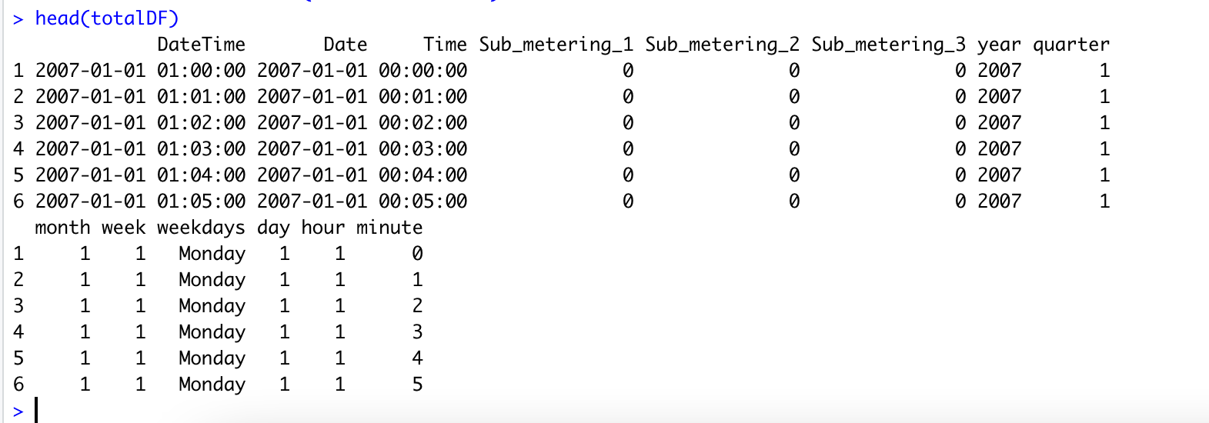
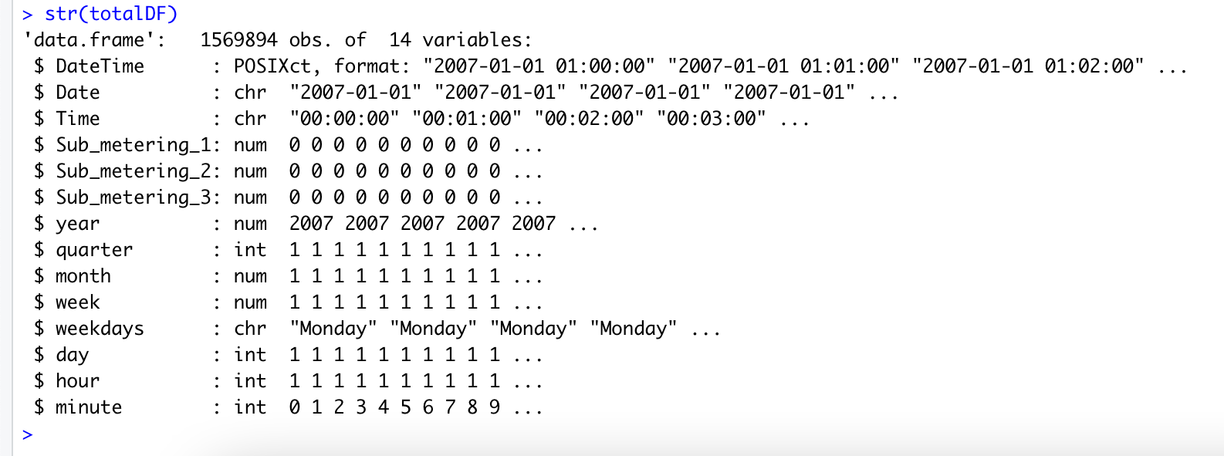
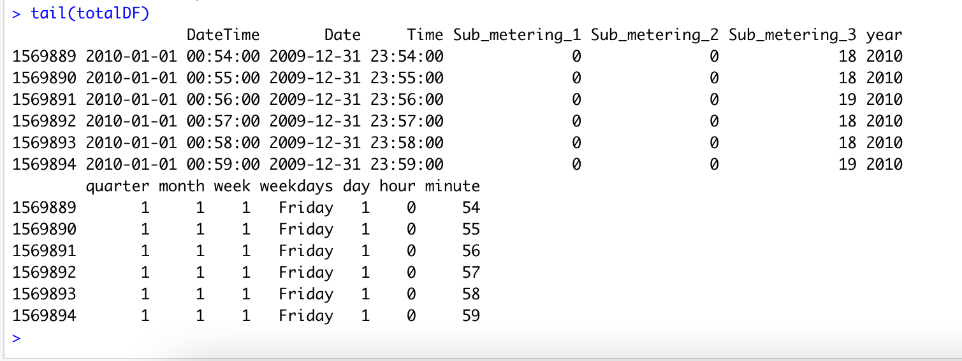
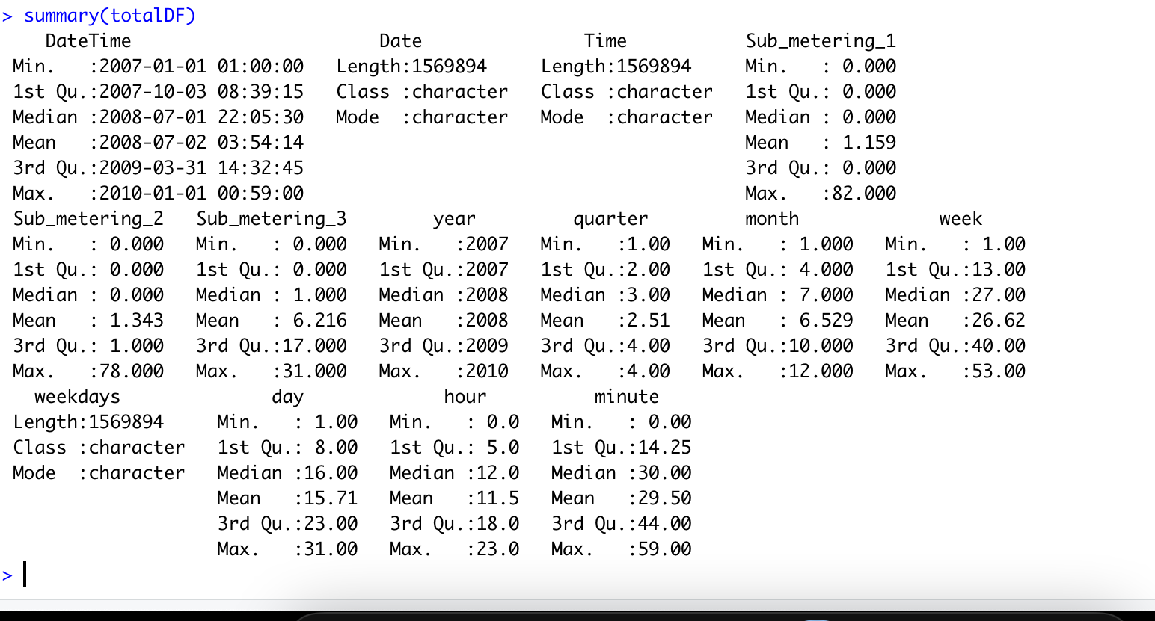
Descriptive Statistics:

Slide 9
Descriptive Statistics
The usage for submeter 3 was on average much more than submeters 1 or 2 Although, both submeters 1 and 2 did see spikes in usage that were much higher than the peak usage of submeter 3 they did not use more energy overall.

Slide 10
Recommendations for client and for additional data:
In order to predict time for return on investment, it would be crucial to know cost per mW/hr of the electricity.
It would be helpful to know the occupancy of each residence as well as whether or not the occupants worked from home. This information would be helpful in predicting future energy consumption for the individual apartments.
It would be interesting to have the apartments further submetered to determine what appliances were causing the most energy consumption. This would also help you in predicting future energy costs for residents.

Slide 11
Closing
In closing, it is our early analysis that submetering can provide useful data for clients. Further analysis of this data will be done to affirm this assertion.

